Slide 1

Stock Prediction and Portfolio Optimization App
Student Name: David Heller
Student ID: 6192583
Mentor: Dr. Florence George
Course Instructor: Dr. Ananda Mondal
Guest Committee Member: Dr. Lina Bouayad
Semester: Fall 2024

Slide 2
Agenda
Introduction
Goals and Objectives
Motivation
Dataset
Methods and Tools
ML Models
Monte Carlo Simulation
App Development
App Demo
Results
Contributions & Conclusions
Future Work
Q&A

Slide 3
Problem Statement
Challenges for individual investors:
Stock market complexity requires knowledge of financial principles like risk management and trend forecasting.
Many investors lack expertise, leading to uninformed decisions and financial losses.
Existing tools are not easily accessible:
Expensive Financial Advisors: Fees range from 0.25% to 1% of assets or up to $400/hour (AdvisoryHQ, 2024).
Complex Analytical Platforms: Tools like Bloomberg Terminal cost $24,000/year and require advanced expertise.
Key Gap: A lack of accessible, user-friendly tools offering actionable insights without high costs or technical barriers.
Notes:
For small investors, the stock market can be overwhelming. Success requires a solid understanding of financial principles, like managing risk and identifying trends. Unfortunately, many small investors lack this expertise, which often leads to uninformed decisions and, in some cases, significant financial losses.
While tools exist, they are not easily accessible to most people. Financial advisors, for example, charge high fees—ranging from 0.25% to 1% of assets under management or up to $400 per hour. Advanced platforms like Bloomberg Terminal are even more out of reach, costing $24,000 per year and requiring advanced technical skills.
This creates a significant gap for small investors: a lack of affordable, user-friendly tools that provide actionable insights. Our project is designed to address this need, empowering small investors with the resources they need to make informed decisions without high costs or technical barriers.

Slide 4
Project Overview
Purpose: To address challenges in stock market investing by creating an accessible, data-driven tool for individual investors.
The Project Aims To:
Enhance Stock Analysis: enable users to visualize trends and assess financial indicators.
Provide Accurate Predictions: Use machine learning models to forecast stock prices.
Optimize Portfolio Allocation: Recommend risk-adjusted allocations via Monte Carlo simulations.
Simplify Analytics: Offer an intuitive, user-friendly interface for all skill levels.
Impact:
Bridges the gap between complex financial analytics and accessibility for individual investors.
Combines real-time data, machine learning, and optimization to empower informed decision-making.
Notes:
The purpose of this project is to tackle the challenges that individual investors face in the stock market by creating an accessible, data-driven tool. We aim to provide a solution that combines advanced analytics with simplicity.
This project focuses on four key goals:
Enhancing Stock Analysis: Allowing users to visualize historical trends and assess key financial indicators for better insights.
Providing Accurate Predictions: Leveraging machine learning models, such as LSTM, to forecast stock prices with precision.
Optimizing Portfolio Allocation: Using Monte Carlo simulations to recommend risk-adjusted investment strategies that balance return and risk.
Simplifying Analytics: Offering an intuitive and user-friendly interface that makes advanced analytics accessible to users of all skill levels.
The impact of this project is significant. It bridges the gap between complex financial analytics and accessibility for small investors, empowering them with real-time data, machine learning insights, and portfolio optimization strategies. Our goal is to enable informed decision-making without the high costs or technical barriers of traditional tools.

Slide 5
Goals and Objectives
Primary Objective:
Develop a fully integrated, data-driven tool for stock market analysis and portfolio optimization.
Goals:
Develop Robust Forecasting Models: Build, evaluate, and compare ARIMA, XGBoost, and LSTM for time-series forecasting.
Implement Portfolio Optimization: Use Monte Carlo simulations to balance risk and return by maximizing the Sharpe ratio.
Create a User-Friendly App: Design an interactive Streamlit application integrating stock analysis, predictions, and portfolio recommendations.
Advance Personal Expertise: Explore new techniques, including deep learning and app development, to strengthen data science skills.

Slide 6
Motivation
1. Addressing Real-World Challenges:
Tackles key investor hurdles: forecasting stock prices and optimizing portfolios.
Integrates machine learning and financial modeling for reliable, data-driven solutions.
2. Personal Alignment:
Combines my finance background with data science expertise.
An opportunity to explore advanced techniques like deep learning and app development.
3. Data-Driven Decisions:
Facilitates investment decisions based on statistical analysis and predictive modeling.
A step toward transforming how investors navigate market complexities.
4. Democratizing Financial Analytics:
Bridges the gap between simplistic tools and complex platforms.
Makes advanced analytics accessible through a user-friendly interface.
Notes:
This project is driven by a combination of real-world challenges, personal alignment, and a desire to make financial analytics accessible to everyone.
First, it addresses two major challenges faced by individual investors: forecasting stock prices and constructing optimized portfolios. By integrating machine learning and financial modeling, the project delivers reliable, data-driven solutions to these hurdles.
Second, this project is a personal opportunity to combine my background in finance with my growing expertise in data science. It also allows me to explore advanced techniques like deep learning and app development, enhancing my skills in meaningful ways.
Third, the project emphasizes the importance of data-driven decisions. By relying on statistical analysis and predictive modeling, it helps investors move away from intuition-based decisions to evidence-based strategies, making their journey through the complexities of the market more effective.
Finally, the project is about democratizing financial analytics. Today, tools are either overly simplistic or far too complex for most individual investors. This app bridges that gap by offering advanced analytics through a user-friendly interface, empowering investors of all skill levels to make informed decisions.

Slide 7
Data Collection
Overview:
Collected 15 years (2009–2024) of daily stock price data. Data was retrieved using Yahoo Finance API via Python’s yfinance library.
Selected Stocks:
Netflix (NFLX), Google (GOOGL), IBM, Johnson & Johnson (JNJ), Coca-Cola (KO), Microsoft (MSFT), Nike (NKE), and Apple (AAPL)
Focused on a manageable dataset for detailed analysis and robust model testing. It provides a foundation for incorporating more stocks into the app in the future.
The 8 stocks represent diverse industries and established market presence. It ensures a well-rounded analysis across key sectors:
Technology: Microsoft, Google, Apple, IBM.
Entertainment: Netflix.
Healthcare: Johnson & Johnson.
Consumer Goods: Coca-Cola.
Apparel: Nike.

Slide 8
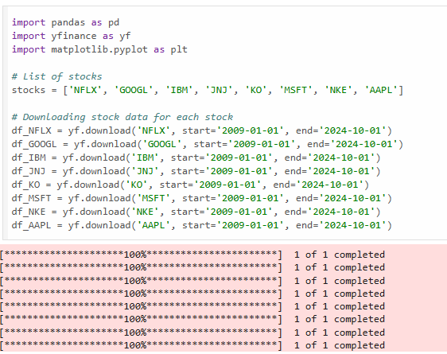
Data Collection Code Snippet

Slide 9
Dataset Description
Size and Dimensionality: 31,696 rows (3,962 rows x 8 stocks) x 7 columns.
Column Descriptions:
Date (set as the index)
Adj Close: Closing price adjusted for dividends and splits (ex. A 2-for-1 stock split would halve the Close price historically, but Adj Close reflects the adjusted price as if the split never occurred). Target variable.
Close: End-of-day stock price.
High: Highest price during the trading session.
Low: Lowest price during the trading session.
Open: Starting price of the trading session.
Volume: Total shares traded during the session.
Data Quality:
No missing values.
Notes:
The Adjusted Close price is a modification of the stock’s closing price that accounts for corporate actions such as stock splits, dividends, and rights offerings. This adjustment ensures that historical prices remain consistent and comparable over time. For example, in the case of a stock split, where one share splits into multiple shares (e.g., a 2-for-1 split), the Adjusted Close recalculates historical prices to reflect the split. If the stock was trading at $200 before a 2-for-1 split, the Adjusted Close would show $100 for consistency. Similarly, when a company pays dividends, the Adjusted Close incorporates the dividend amount to reflect the total value received by an investor, including both the price and the dividend.

Slide 10
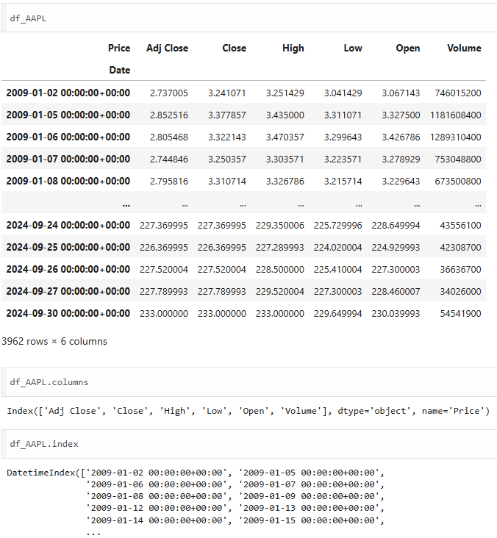
Apple’s Dataset

Slide 11
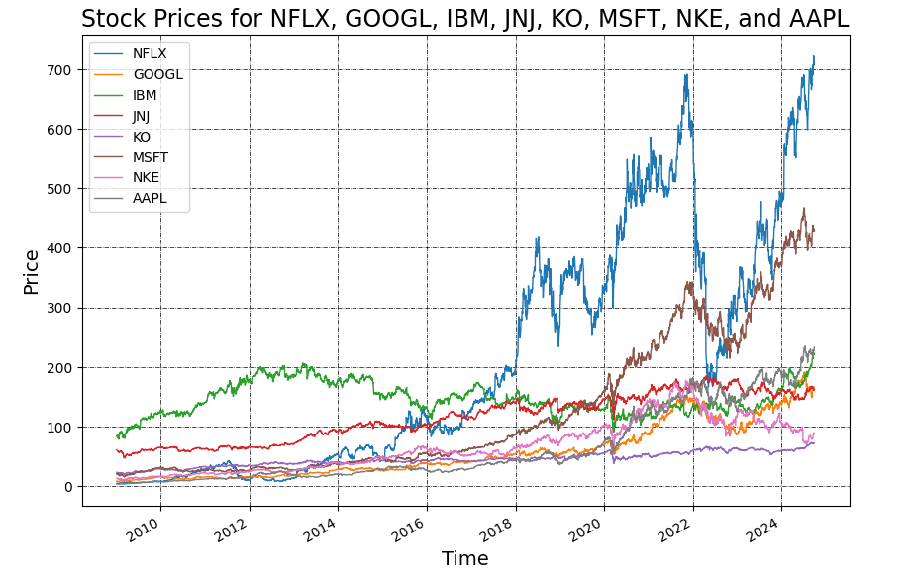
Visualizing Stock Prices
Notes:
This visualization shows the stock prices of eight major companies—Netflix, Google, IBM, Johnson & Johnson, Coca-Cola, Microsoft, Nike, and Apple—over the last 15 years, from 2009 to 2024.
Each line represents the price movement of a specific stock over time. As we can see, companies like Netflix (NFLX) and Apple (AAPL) have experienced significant growth, reflecting their leadership in their respective industries. Other stocks, like Coca-Cola (KO) and Johnson & Johnson (JNJ), show steadier, less volatile trends, representing stability in consumer staples and healthcare sectors.
This chart highlights the diverse price behaviors across industries, illustrating both growth potential and risk levels. These differences are essential for understanding market dynamics and play a critical role in our analysis for both stock price predictions and portfolio optimization.

Slide 12
Feature Engineering
Feature engineering transforms raw data into meaningful inputs for predictive modeling. In this project, 55 new features were engineered to enhance the accuracy of stock price predictions and portfolio optimization.
Key Features:
Lag Variables: Historical closing prices (e.g., t-1, t-5)
Moving Averages: MA5, MA10, MA50, MA200, etc.
Volatility Metrics: Bollinger Bands, ATR, and ADX.
Momentum Indicators: RSI, MACD, William’s %R, Stochastic %K.
Date Features: Day, Month, Week, Year, Quarter Start/End, etc.
Dataset Summary:
Size: Over 30,000 rows and 61 columns across 8 stocks. This provides comprehensive insights into short- and long-term market trends.
Practical Considerations:
Advanced features were excluded in the final app to prioritize real-time functionality and user accessibility. The app focuses on instant predictions, ensuring minimal delays for users.
Impact:
Although not included in the final model, these features demonstrate a robust and iterative feature engineering approach, laying the groundwork for future improvements.
Notes:
In this project, we engineered 55 features, including lag variables, moving averages, volatility metrics like Bollinger Bands and ATR, momentum indicators like RSI and MACD, and date-based features such as day, month, and quarter. These features were designed to improve predictive accuracy by capturing both short- and long-term trends in stock prices.
However, these advanced features were excluded from the final app for practical reasons. The app’s primary goal is to deliver real-time predictions, and many of these features rely on historical data and extensive pre-processing. Incorporating them would have introduced delays and made the app less responsive, which goes against our focus on providing instant, user-friendly functionality.
Although these features are not part of the app, their development reflects a thorough feature engineering process. This work lays the groundwork for potential future updates.

Slide 13
Machine Learning Models
This project explored three machine learning models to forecast stock prices and compared their performance:
ARIMA: Traditional time-series model suitable for linear trends and stationary data.
XGBoost: A gradient-boosting algorithm designed for speed and accuracy in non-linear patterns.
LSTM: A deep learning model capable of capturing long-term dependencies in sequential data.
Objective:
Evaluate and compare the performance of these models to identify the best-performing one for integration into the app.
Conclusion:
LSTM outperformed ARIMA and XGBoost across stocks, demonstrating superior accuracy and the ability to handle dynamic market behavior. It was integrated into the app for stock price forecasting.
Notes:
In this project, we evaluated three machine learning models to forecast stock prices, each with its unique strengths and limitations.
ARIMA is a traditional time-series model that works well for linear trends and stationary data. However, it struggles with the non-linear and volatile nature of stock market data.
XGBoost is a gradient-boosting algorithm known for its speed and accuracy in handling non-linear relationships. Despite its strength with structured data, it lacks the ability to capture sequential dependencies essential for time-series forecasting.
LSTM, a deep learning model, is specifically designed to capture long-term dependencies in sequential data. This makes it well-suited for dynamic and complex patterns, like stock price movements.
Our objective was to compare these models and identify the best-performing one for integration into the app. After rigorous testing, LSTM emerged as the most accurate model across all stocks, showcasing its ability to handle the volatility and complexity of financial data.
As a result, LSTM was integrated into our app to provide reliable stock price forecasts for users, enhancing their ability to make informed investment decisions.

Slide 14
ARIMA Model Theory
ARIMA (Auto-Regressive Integrated Moving Average) is a statistical model used for univariate time series forecasting.
It combines three components:
AR (Auto-Regressive): Predicts future values based on past observations.
I (Integrated): Differencing the data to achieve stationarity (constant mean and variance).
MA (Moving Average): Models the relationship between current values and past prediction errors.
Strengths:
Effective for linear and stationary time series patterns.
Simple to implement and interpret, making it a useful baseline model.
Limitations for Stock Prediction:
Assumes linear relationships, which may not capture complex stock market dynamics.
Struggles with high volatility, seasonality, and non-linear trends common in financial data.
Notes:
ARIMA, which stands for Auto-Regressive Integrated Moving Average, is a statistical model designed for univariate time series forecasting. It combines three key components to make predictions.
The first component, Auto-Regressive, or AR, predicts future values by using past observations. For example, in an AR(2) model, the next value is calculated based on the last two observed values. The second component, Integrated, involves differencing the data to achieve stationarity, which means ensuring the data has a constant mean and variance over time. This is a critical step for time series models like ARIMA to work effectively. The third component, Moving Average, accounts for relationships between the current value and past prediction errors, essentially correcting for residual inaccuracies.
ARIMA has several strengths. It’s effective for linear and stationary time series patterns, and it’s relatively simple to implement and interpret, making it a useful baseline model.
However, ARIMA also has limitations when applied to stock price prediction. It assumes linear relationships, which often fail to capture the complex, non-linear dynamics of stock markets. Additionally, it struggles with high volatility, seasonality, and sudden market shifts, which are common in financial data. These limitations highlight the need for more advanced models when dealing with stock price forecasting.

Slide 15
XGBoost Model Theory
What is XGBoost?
XGBoost (eXtreme Gradient Boosting) is a powerful machine-learning algorithm based on gradient boosting.
It builds decision trees sequentially, optimizing for speed and accuracy.
Handles non-linear relationships effectively, making it ideal for structured/tabular data.
Strengths:
Highly efficient with fast training times and scalability.
Incorporates regularization techniques to prevent overfitting.
Well-suited for non-linear patterns in data.
Limitations for Stock Prediction:
Lacks the sequential memory required for time series data.
Does not natively account for temporal dependencies in stock prices.
Notes:
XGBoost, short for eXtreme Gradient Boosting, is a machine learning algorithm based on the concept of gradient boosting. Gradient boosting works by building decision trees sequentially, where each tree tries to correct the errors of the previous one. This step-by-step improvement makes XGBoost both highly efficient and accurate.
One of its key strengths is its ability to handle non-linear relationships effectively, which makes it particularly suitable for structured or tabular data. Additionally, XGBoost is designed for speed and scalability, making it ideal for large datasets. It also incorporates regularization techniques, such as L1 and L2 penalties, to prevent overfitting and ensure better generalization.
However, XGBoost does have limitations when applied to stock price prediction. It lacks the sequential memory required for time series data, which means it cannot inherently understand the order of data points over time. Additionally, it does not natively account for temporal dependencies, such as trends or patterns that evolve in stock prices. These limitations make XGBoost less suited for sequential data like time series but highly effective for non-linear and independent patterns.
Gradient boosting is a machine learning technique that builds a strong predictive model by combining multiple weak learners, typically decision trees. It works iteratively by first creating a baseline model, such as predicting the mean of the target variable, and then refining predictions by focusing on residual errors. Each new tree is trained on these errors and added to the model's predictions, scaled by a learning rate to control overfitting. While effective, traditional gradient boosting can be computationally intensive and lacks parallelization, limiting its efficiency.
XGBoost, or Extreme Gradient Boosting, improves upon this framework with features like L1 and L2 regularization to reduce overfitting, tree pruning for efficient structures, and parallelized tree construction to accelerate computation. It also handles missing data natively, uses a novel weighted quantile sketch algorithm for imbalanced datasets, and supports custom loss functions for flexibility. These enhancements make XGBoost faster, more accurate, and better suited for real-world, large-scale data challenges.

Slide 16
Introduction to LSTM
What is LSTM?
Long Short-Term Memory (LSTM) is a type of Recurrent Neural Network (RNN) designed to process and predict sequential data.
Solves the vanishing gradient problem of traditional RNNs, allowing it to learn long-term dependencies.
Why LSTM?
Ideal for applications like time-series forecasting, stock price prediction, and speech recognition.
Retains relevant information over time while discarding irrelevant data.
Notes:
LSTM stands for Long Short-Term Memory, a type of neural network used to process sequences of data, like stock prices over time. Traditional neural networks struggle with data where the order of information matters—like predicting tomorrow’s stock price based on today’s and yesterday’s prices. That’s where RNNs, or Recurrent Neural Networks, come in. RNNs have a built-in memory to keep track of past data, but they face a problem called the vanishing gradient, where they ‘forget’ important details when sequences are too long.
LSTMs solve this by using a more advanced memory system that remembers what’s important and forgets the rest. This makes them great at learning from patterns in time-series data, like predicting trends in stock prices or understanding sentences in natural language

Slide 17
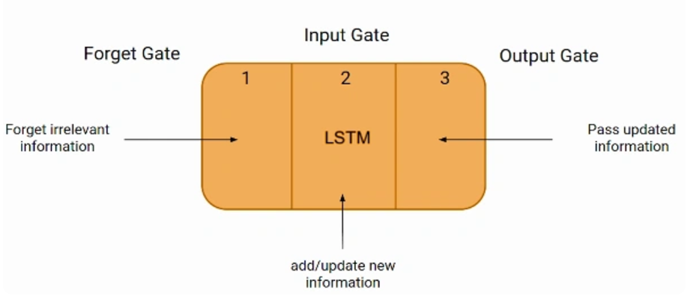
How Does LSTM Work?
LSTM manages information flow using three gates and a cell state:
Forget Gate: Decides what information to discard from the cell state.
Input Gate: Determines what new information to add to the cell state.
Cell State: Acts as memory, updated by the forget and input gates.
Output Gate: Filters the updated cell state to produce the final output.
Key Feature: Gating mechanisms allow LSTM to focus on relevant data and ignore noise.
Image source: https://www.analyticsvidhya.com/blog/2021/03/introduction-to-long-short-term-memory-lstm/
Notes:
LSTMs manage information through a clever system of gates, which are like checkpoints deciding what to remember, what to update, and what to use for predictions.
The Forget Gate decides which information to discard from past data. For example, if some old trends are no longer relevant, this gate clears them out.
The Input Gate adds new information to memory. It evaluates the current data and decides what’s useful to keep.
The Output Gate filters the updated memory to decide what to use for the current prediction.
All this is coordinated through the Cell State, which acts as the memory of the model, flowing through the network and keeping relevant information intact. These gates make LSTMs powerful because they can focus on what matters and ignore what doesn’t.

Slide 18
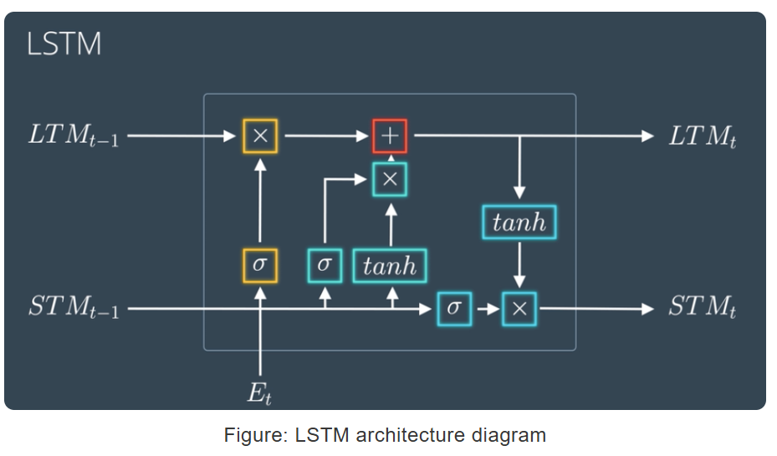
LSTM in Detail
Image source: https://www.analyticsvidhya.com/blog/2021/01/understanding-architecture-of-lstm/
Notes:
This diagram illustrates the internal workings of an LSTM cell, which manages two types of memory: long-term memory (LTM) and short-term memory (STM). At each time step, the cell takes three inputs: the long-term memory (LTM from the previous step), the short-term memory (STM from the previous step), and the current input (such as a stock price or feature value).
The process begins with the forget gate (yellow block), which determines what information from the long-term memory should be discarded. This decision is made using a sigmoid activation function, which assigns a value between 0 (forget) and 1 (keep) for each piece of information. Next, the input gate (blue blocks) evaluates the current input and generates candidate values using a tanh function. The sigmoid activation in the input gate decides which of these candidate values should be added to the long-term memory. Together, the forget and input gates update the long-term memory (LTM) by removing outdated information and adding relevant new data.
The cell state update (red block) is where the updated long-term memory (LTM) is calculated. The output of the forget gate removes irrelevant information, and the input gate adds new, relevant data to update the memory effectively.
The output gate (green blocks) determines what part of the updated long-term memory should contribute to the short-term memory (STM) and the current output. It combines the current input, updated long-term memory, and a scaled version of the memory (using tanh), filtered through another sigmoid activation. This updated short-term memory is used for the current prediction and passed to the next cell in the sequence.
The dual outputs of the LSTM cell—updated long-term memory (LTM) and short-term memory (STM)—allow it to retain essential information across long sequences while responding dynamically to immediate context. By managing memory flow through these gates, LSTMs can effectively capture long-term dependencies and trends, making them highly suitable for tasks like stock price forecasting.

Slide 19
LSTM for Stock Price Prediction
Advantages of LSTM:
Captures long-term dependencies in sequential data.
Handles non-linear and dynamic stock price patterns.
Resilient to noisy, volatile financial data.
Why It Works for Stock Data:
Stocks have temporal dependencies (price today depends on past trends).
LSTM’s ability to store and process sequential patterns makes it ideal for this use case.
Notes:
Stock prices are tricky because they depend on trends, seasonal patterns, and sudden changes like news or market events. LSTMs are perfect for this because:
They can look far back into the past and remember long-term trends.
They handle noisy and unpredictable data better than most models.
Unlike simpler models, LSTMs adapt to the dynamic and non-linear nature of stock price movements.
This makes LSTMs ideal for predicting stock prices, which are influenced by both short-term fluctuations and long-term patterns.

Slide 20
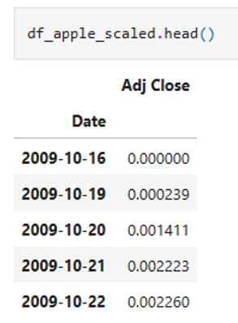
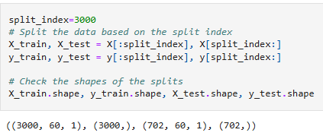
Preparing Data for LSTM
Scaling:
Adjusted closing prices scaled to [0,1] using MinMaxScaler for numerical stability.
Sequence Creation:
A window size of 60 days was used. The model predicts the next day’s price based on the previous 60 days.
Data Splitting:
Chronologically split into training (80%) and testing (20%) sets to avoid information leakage.
Notes:
Before training the LSTM, the data needs to be prepared in a specific way. First, we scaled the stock prices to values between 0 and 1. This step, called normalization, ensures the model treats all numbers equally, regardless of their original range.
Next, we created sequences. For example, if we’re predicting tomorrow’s price, we use the prices from the past 60 days as input. This way, the model learns patterns from the sequence to make predictions.
Finally, we split the data into two parts: one for training the model and the other for testing it. We used the earlier data for training and saved the most recent data for testing, to simulate how the model would perform on future prices.

Slide 21
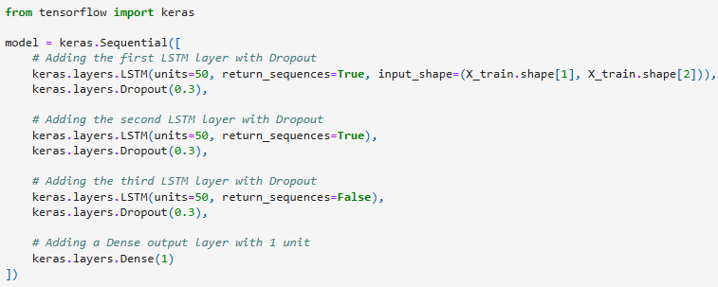
LSTM Model Design
Layers:
First LSTM Layer: 50 units, return sequences enabled to pass full sequence to the next layer.
Second LSTM Layer: 50 units, further refines temporal patterns.
Third LSTM Layer: 50 units, outputs only the final time step.
Dropout Layers: 30% dropout after each LSTM layer to prevent overfitting.
Output Layer:
A Dense layer with one unit for predicting the next day’s price.
Notes:
Our LSTM model has three main layers, each with 50 units, which means it can learn 50 patterns at a time. The first two layers pass the entire sequence to the next layer, helping the model build a strong understanding of the data. The third layer condenses all that information into a single prediction.
To prevent the model from overfitting—where it performs well on training data but poorly on new data—we added dropout layers. These layers randomly ignore 30% of the neurons during training, forcing the model to learn more general patterns.
Finally, a dense layer at the end produces the output: the predicted stock price for the next day.

Slide 22
LSTM Model Design: Summary of Workflow
• The first LSTM layer takes sequential input and extracts temporal features.
• The subsequent LSTM layers build on these features, capturing more abstract and complex patterns in the data.
• Dropout layers reduce the risk of overfitting by randomly deactivating some neurons.
• The Dense layer produces the final output, which is the predicted value for the input sequence.

Slide 23
Training the LSTM Model
Key Elements:
Optimizer: Adam, dynamically adjusts learning rates for efficient optimization.
Loss Function: Mean Squared Error (MSE), ideal for regression tasks.
Early Stopping: Monitors validation loss and stops training when no improvement is observed for 5 epochs.
Validation Split: 20% of training data set aside for validation.
Configuration:
Epochs: Max of 100, but early stopping usually halts training earlier.
Batch Size: 32 samples per batch.
Notes:
We trained the LSTM model using a process called optimization. The optimizer we used is called Adam, which adjusts the model’s learning rate dynamically to make training efficient. To measure how well the model predicts, we used a loss function called Mean Squared Error. It calculates the difference between predicted and actual prices, penalizing larger mistakes more.
To avoid overfitting, we used early stopping. If the model doesn’t improve after 5 tries, training stops automatically, saving time and ensuring the model doesn’t memorize the data instead of learning patterns.
When you set a maximum of 100 epochs and a batch size of 32, it means the model will go through the entire dataset up to 100 times during training. An epoch refers to one full pass through the dataset, while the batch size determines how many samples (rows of data) the model processes at a time before updating its weights. This process is repeated for up to 100 epochs or until early stopping criteria are met to prevent overfitting. A smaller batch size, like 32, allows the model to update its weights more frequently, which can help it learn faster, while multiple epochs ensure the model refines its predictions by revisiting the data repeatedly.

Slide 24
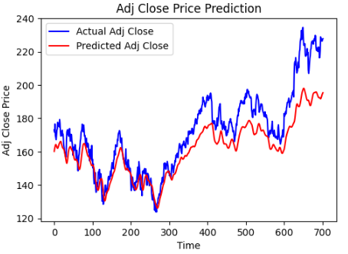
Evaluating LSTM Performance (Apple Stock)
Metrics:
Mean Absolute Error (MAE): 11.03.
Root Mean Squared Error (RMSE): 13.83.
Mean Squared Error (MSE): 191.28.
Insights:
Effectively captures long-term trends.
Struggles with sharp fluctuations, smoothing out sudden price changes.
Notes:
After training the model, we evaluated it using three metrics:
Mean Absolute Error (MAE): This tells us the average error in the model’s predictions.
Root Mean Squared Error (RMSE): This gives more weight to larger errors, helping us understand how bad the worst predictions are.
Mean Squared Error (MSE): Similar to RMSE but focuses on the overall accuracy.
For Apple stock, the model performed well, with an MAE of 11.03. The graph shows how the model’s predictions closely follow the actual stock prices. While it does well with long-term trends, it struggles a bit with sudden changes, which is expected due to the unpredictable nature of stock markets.

Slide 25
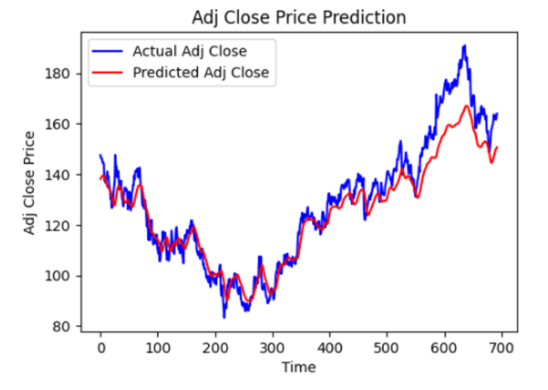
Evaluating LSTM Performance (Google)

Slide 26
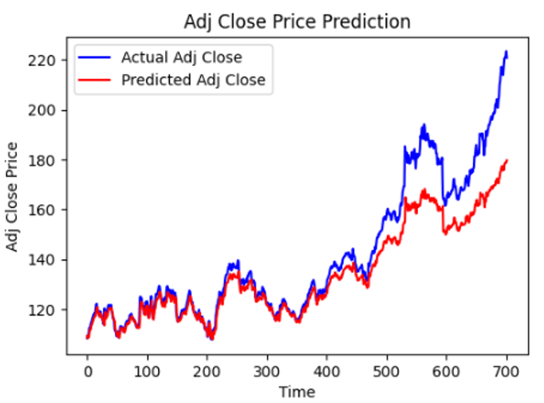
Evaluating LSTM Performance (IBM)

Slide 27
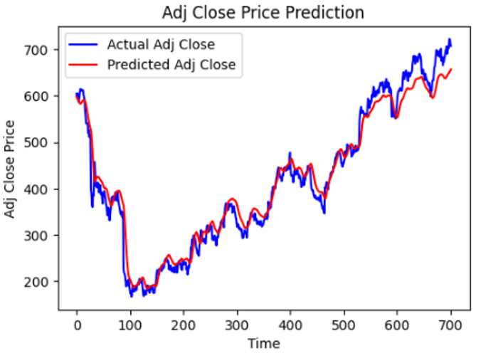
Evaluating LSTM Performance (Netflix)

Slide 28
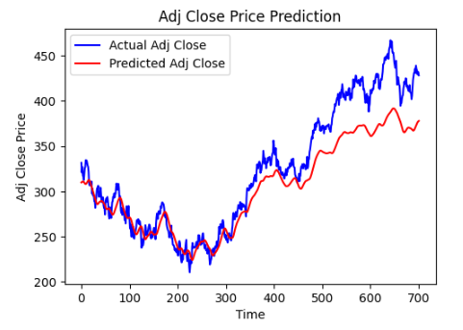
Evaluating LSTM Performance (Microsoft)

Slide 29
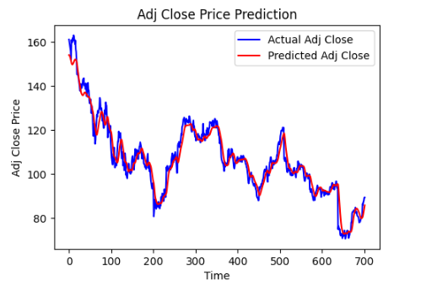
Evaluating LSTM Performance (Nike)

Slide 30
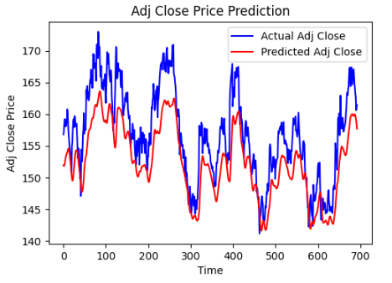
Evaluating LSTM Performance (J&J)

Slide 31
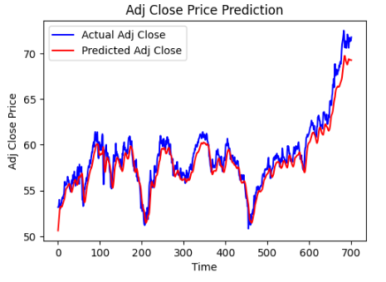
Evaluating LSTM Performance (Coca-Cola)

Slide 32
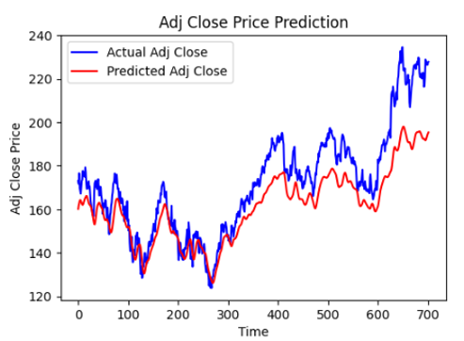
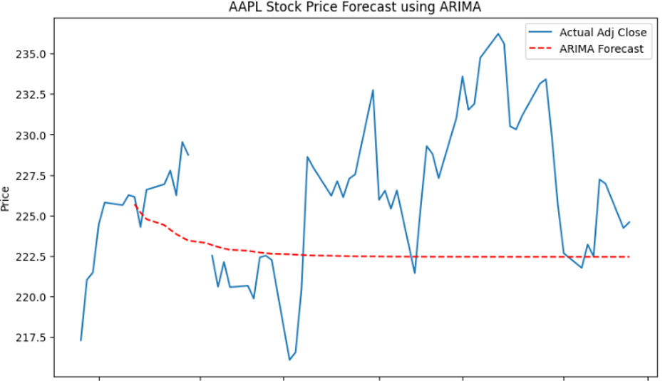
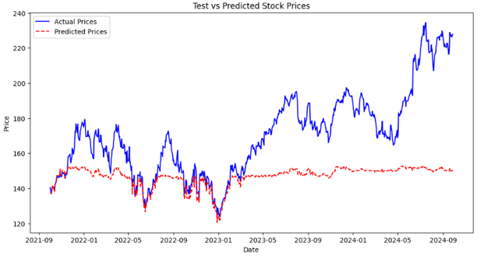
Models Behavior (Apple Stock)
LSTM ARIMA XGBoost
Time
Notes:
This slide illustrates the performance of the three models—LSTM, ARIMA, and XGBoost—on Apple’s stock price prediction.
Starting with LSTM on the left, we can see it closely follows the actual price trends, effectively capturing both short-term fluctuations and long-term dependencies. In contrast, ARIMA in the center fails to capture the dynamic trends, providing flat forecasts that don't adapt well to the price volatility. On the right, XGBoost struggles with sequential patterns, producing smoother but less accurate predictions.
Overall, LSTM outperforms the other models, demonstrating its ability to handle the complexity and non-linearity of stock price movements.

Slide 33
Why LSTM Was the Best Model
Compared to ARIMA:
ARIMA struggled with non-linear patterns and volatile market behavior.
Compared to XGBoost:
XGBoost lacked sequential memory, which is critical for time series.
Why LSTM Stands Out:
Handles sequential dependencies and captures dynamic trends.
Robust against noisy data and volatility.
Integration:
LSTM was chosen for the app due to its superior performance and real-world relevance.
Notes:
Compared to ARIMA and XGBoost, LSTM was the most accurate and reliable for predicting stock prices. ARIMA struggled with non-linear trends, and XGBoost didn’t handle time dependencies well. LSTM stood out because it could remember patterns over time and adapt to the dynamic, volatile nature of stock markets.
This is why we integrated LSTM into our app. It provides users with accurate predictions that align with real-world stock behaviors, making it the best choice for our project.

Slide 34
Portfolio Optimization: Monte Carlo Simulations
What is Portfolio Optimization?
The goal is to allocate investments across assets to maximize returns while minimizing risk.
The Sharpe Ratio is used to measure performance, balancing risk and return.
What is a Monte Carlo Simulation?
A statistical method that runs thousands of simulations to predict possible outcomes.
Each simulation randomly samples asset returns and evaluates portfolio performance.
Application in the Project:
Simulated 10,000 potential portfolio allocations for 8 selected stocks.
Optimized allocations to maximize the Sharpe Ratio, providing a balance between high returns and low volatility.
Output:
Generated optimal weights for each stock in the portfolio.
Visualized the Efficient Frontier, showcasing the trade-off between risk and return.
Notes:
Portfolio optimization is about finding the best way to allocate investments across assets to maximize returns while managing risk. In our project, we used the Sharpe Ratio as the performance metric, which balances the trade-off between risk and return.
To achieve this, we applied Monte Carlo simulations. A Monte Carlo simulation is a powerful statistical tool that randomly generates thousands of scenarios to predict potential outcomes. In the context of portfolio optimization, it evaluates a wide range of asset allocations by simulating potential returns for each one.

Slide 35
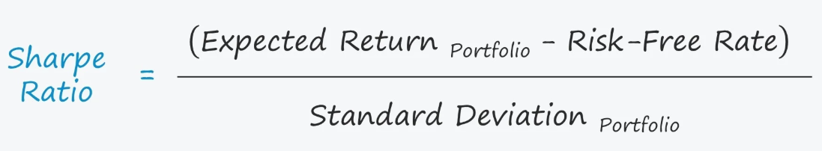
The Sharpe Ratio and Monte Carlo Simulation Explained
What is the Sharpe Ratio?
A measure of risk-adjusted returns. A higher Sharpe Ratio equals better return per unit of risk.
Formula:
Source: https://www.wallstreetprep.com/knowledge/sharpe-ratio/
Monte Carlo Simulation in the App:
Simulates 10,000 portfolio allocations by assigning random weights to the selected stocks.
For each allocation, it calculates:
Portfolio Return.
Portfolio Volatility.
Sharpe Ratio.
Identifies the allocation with the highest Sharpe Ratio.
It explores a wide range of possible outcomes and provides a robust optimization by accounting for uncertainty in stock returns.
Notes:
The Sharpe Ratio measures risk-adjusted returns. It compares the excess return of a portfolio—meaning the return above a risk-free rate—to the portfolio’s volatility. The formula is straightforward: subtract the risk-free rate from the portfolio return, then divide by volatility. A higher Sharpe Ratio indicates better risk-adjusted performance, helping us balance returns with the risks taken.
Now, how does Monte Carlo simulation work in this app? We simulate 10,000 portfolio allocations by randomly assigning weights to our selected stocks. For each allocation, we calculate the portfolio's return, volatility, and Sharpe Ratio. The goal is to find the allocation with the highest Sharpe Ratio, which provides the best balance of risk and reward.
Monte Carlo simulation is particularly useful here because it explores a wide range of possible outcomes, accounting for the inherent uncertainty in stock returns. This allows us to provide robust recommendations for portfolio optimization.

Slide 36
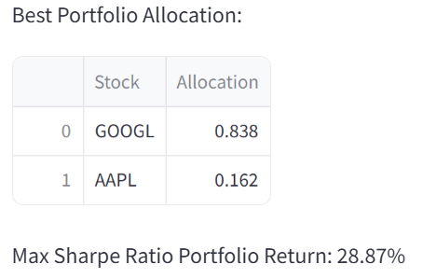
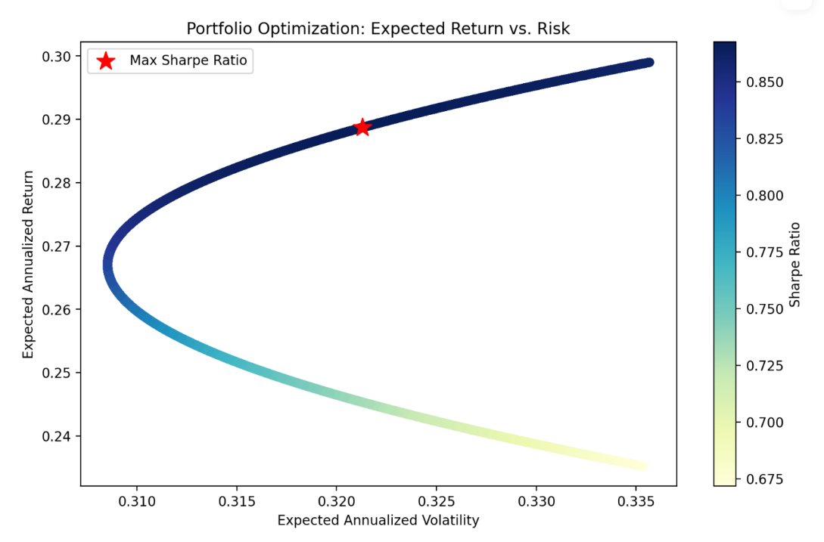
Portfolio Optimization Example
Notes:
The results of the Monte Carlo simulation are visualized on the Efficient Frontier. Each point represents a portfolio allocation with its corresponding risk and return. The curve shows the best possible portfolios, which maximize return for a given level of risk. Among these, the optimal portfolio—highlighted here—achieves the highest Sharpe Ratio, providing the best balance between risk and reward. This optimal allocation is what we recommend to users for constructing their portfolios.

Slide 37
App Development
Overview:
Developed an interactive app using Streamlit, a Python-based framework for building data-driven applications.
Designed for both novice and experienced investors with a user-friendly interface.
App Features:
Stock Exploration: Allows users to analyze historical trends and key metrics for selected stocks.
Price Predictions: Utilizes the LSTM model to forecast stock prices for the next day/week/month.
Portfolio Optimization: Provides users with optimal portfolio allocations based on Monte Carlo simulations.
Deployment:
Deployed on Streamlit Cloud for easy access.
Integrated pre-trained LSTM models hosted on GitHub for real-time predictions.
Notes:
Our app was developed using Streamlit, a powerful Python framework for creating interactive data applications. The goal was to create a tool that is both accessible to novice investors and feature-rich for more experienced users.
The app includes three main functionalities:
A Stock Exploration tab that allows users to dive into historical trends and analyze stock-specific metrics.
A Price Prediction tab powered by the LSTM model, which provides forecasts for the next day, week, or month.
A Portfolio Optimization tab, where users can input their stocks, and the app recommends the optimal allocation using Monte Carlo simulations.
To ensure a seamless experience, the app was deployed on Streamlit Cloud, making it accessible from any device. Pre-trained LSTM models were hosted on GitHub and integrated into the app to provide real-time predictions.
The interface was designed with simplicity in mind, requiring minimal input from users while delivering actionable insights. This balance between functionality and ease of use makes the app a powerful tool for investors.

Slide 38
App Demo
https://stock-forecast-and-allocate.streamlit.app/

Slide 39
Results
Best Performing Model:
LSTM outperformed ARIMA and XGBoost for stock price predictions, capturing long-term trends effectively.
Portfolio Optimization:
Monte Carlo simulations identified optimal stock allocations, maximizing the Sharpe Ratio for balanced risk and return.
App Performance:
Delivered accurate stock forecasts and actionable portfolio recommendations in an intuitive, user-friendly interface.
Insights:
Machine learning models like LSTM excel at handling sequential and volatile financial data.
Monte Carlo simulations provide robust optimization strategies for diverse portfolios.
Notes:
Our project achieved significant results, starting with the machine learning models. Among the models tested, LSTM emerged as the best-performing, capturing long-term trends in stock prices while handling the volatility inherent in financial data. On the optimization side, Monte Carlo simulations successfully identified optimal portfolio allocations, maximizing the Sharpe Ratio to balance risk and return.
The app itself integrated these components effectively, delivering accurate stock forecasts and actionable portfolio recommendations through a user-friendly interface. This makes advanced financial tools accessible to individual investors, regardless of their technical expertise.
The insights gained from this project are twofold. First, advanced models like LSTM are well-suited for handling the complexities of financial data. Second, simulation techniques like Monte Carlo provide robust frameworks for portfolio optimization.

Slide 40
Contributions & Conclusions
Key Contributions:
Developed a robust, end-to-end tool combining machine learning and financial modeling.
Demonstrated the practical application of LSTM for stock price prediction.
Simplified complex financial analytics for individual investors through an accessible app.
Conclusions:
The app bridges the gap between advanced data science techniques and user-friendly tools.
Empowers users to make data-driven investment decisions with minimal technical expertise.

Slide 41
Future Work
Enhancing App Features:
Incorporate more stocks and financial metrics.
Add real-time data streaming for live predictions and portfolio updates.
Improving Model Performance:
Explore hybrid models combining LSTM with other techniques for better accuracy.
Integrate external factors like market sentiment or economic indicators.
Scalability:
Expand app functionality to support institutional investors.
Offer customizable settings for advanced users.
Educational Features:
Include tutorials or explainers to help novice investors understand analytics.

Slide 42

Questions?

Slide 43

Thank You!

